Slide 1


ITI Examination System Project
Meat Our Team
Ibrahim Abdelazeam
Computer Systems Engineering - 2023
Mahmoud Mohamed
Computer Systems Engineering- 2023
Haitham Fathy
Computer Systems Engineering- 2023
Ahmed Arab
Ziad Mohamed
Navigation Science & Space Technology -2024
Computer Systems Engineering -2023

Slide 2
Meet Our Team
ITI Examination System Project
Ibrahim Abdelazeam
Computer Systems Engineering - 2023
Mahmoud Mohamed
Computer Systems Engineering- 2023
Haitham Fathy
Computer Systems Engineering- 2023
Ahmed Arab
Ziad Mohamed
Navigation Science & Space Technology -2024
Computer Systems Engineering -2023

Slide 3
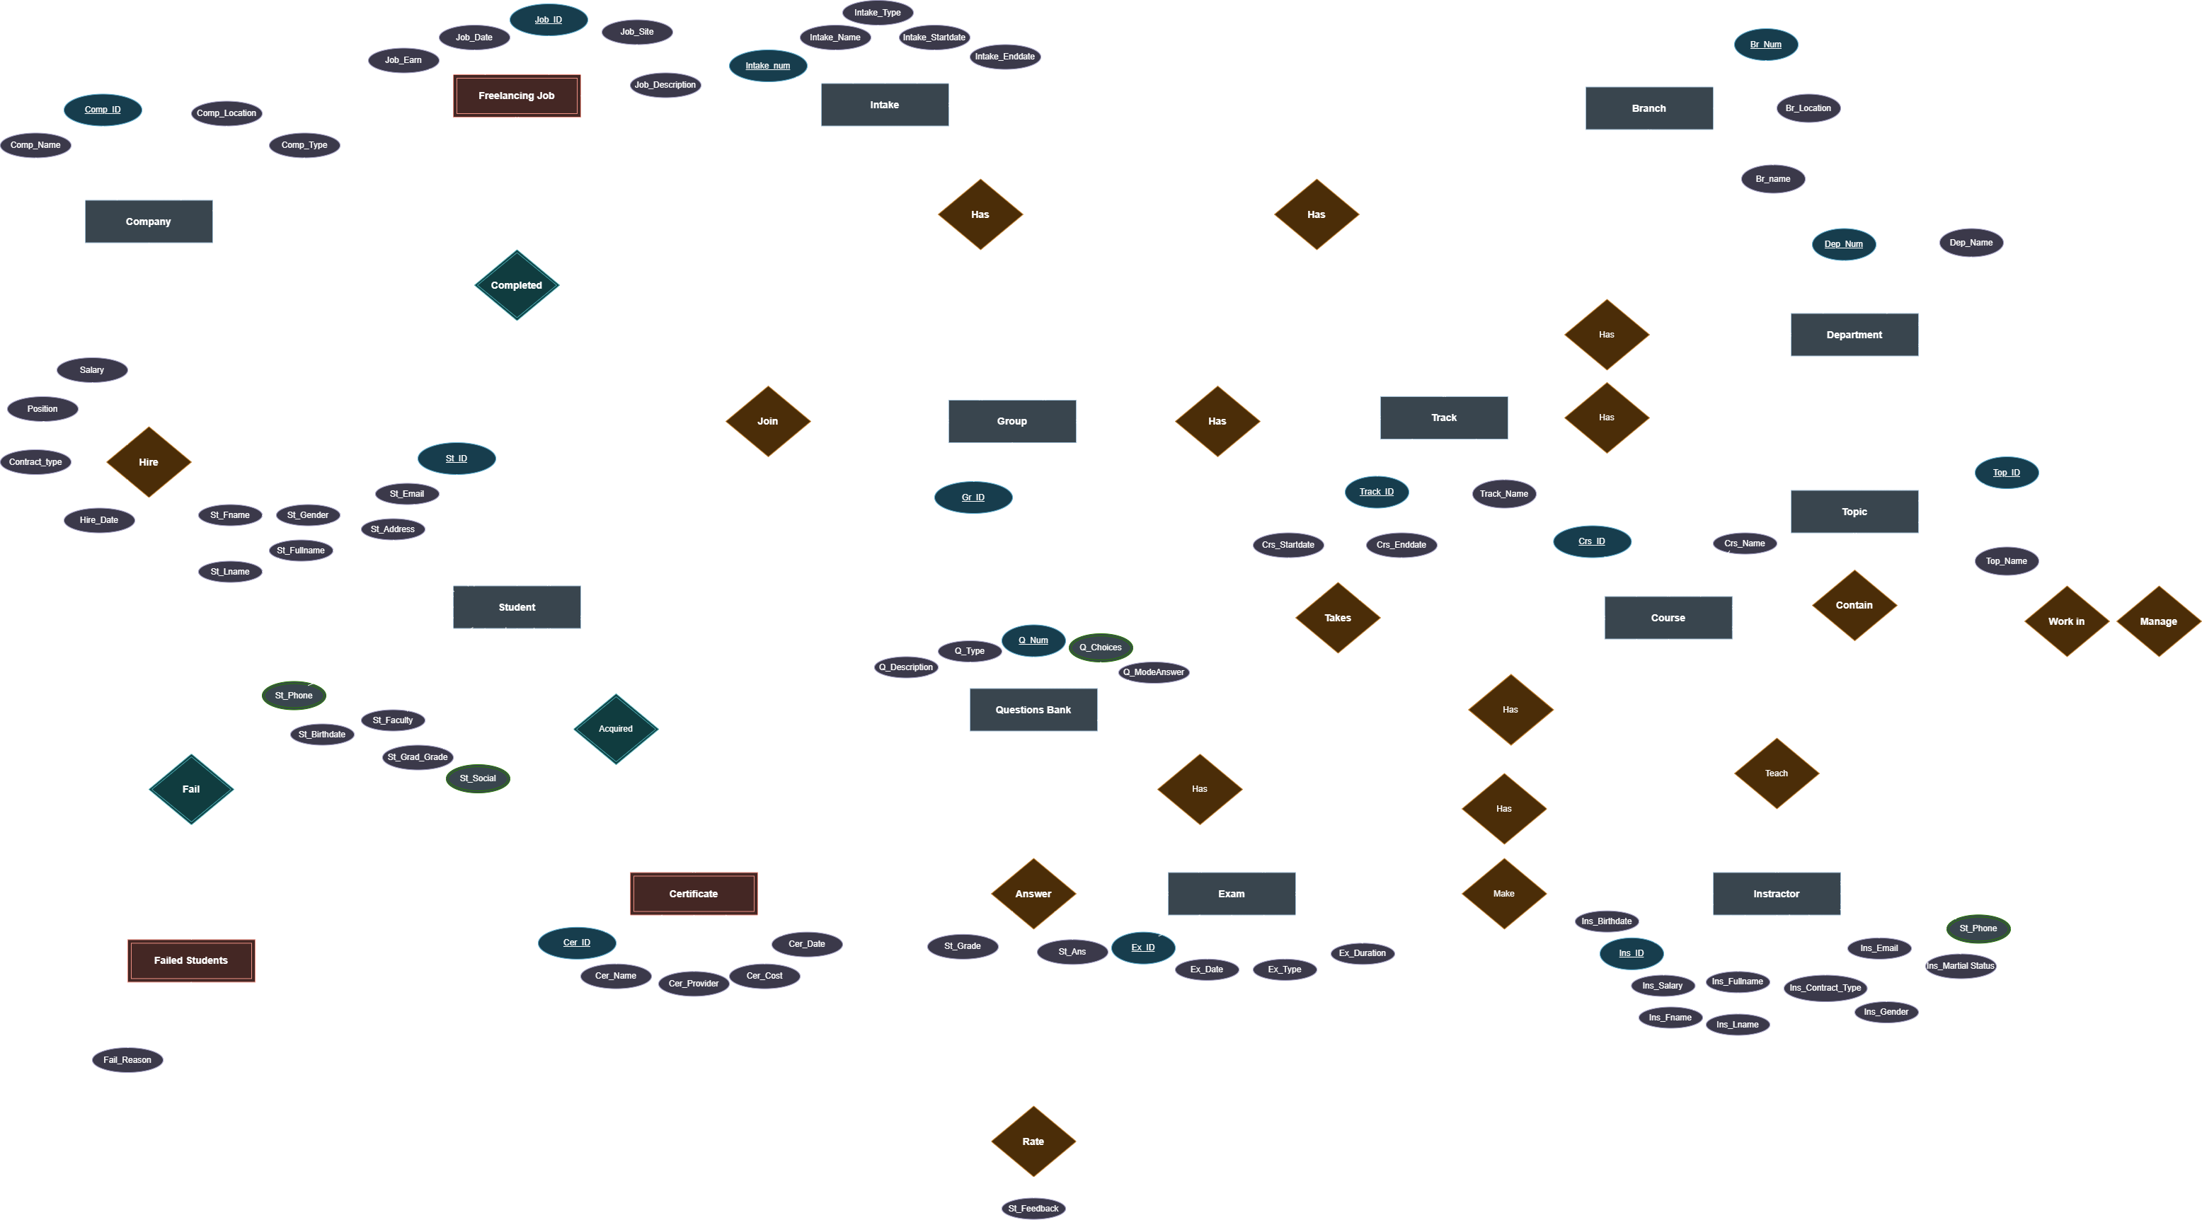
Meet Our Team
Content
1
ERD
2
Mapping
3
5
7
4
Database
BI Tools
Dashboards
6
AI Models
Automation
8
Web App
9
Project Preview
10
Task Allocation
Ibrahim Abdelazeam
Computer Systems Engineering - 2023
Mahmoud Mohamed
Computer Systems Engineering- 2023
Haitham Fathy
Computer Systems Engineering- 2023
Ahmed Arab
Ziad Mohamed
Navigation Science & Space Technology -2024
Computer Systems Engineering -2023

Slide 4
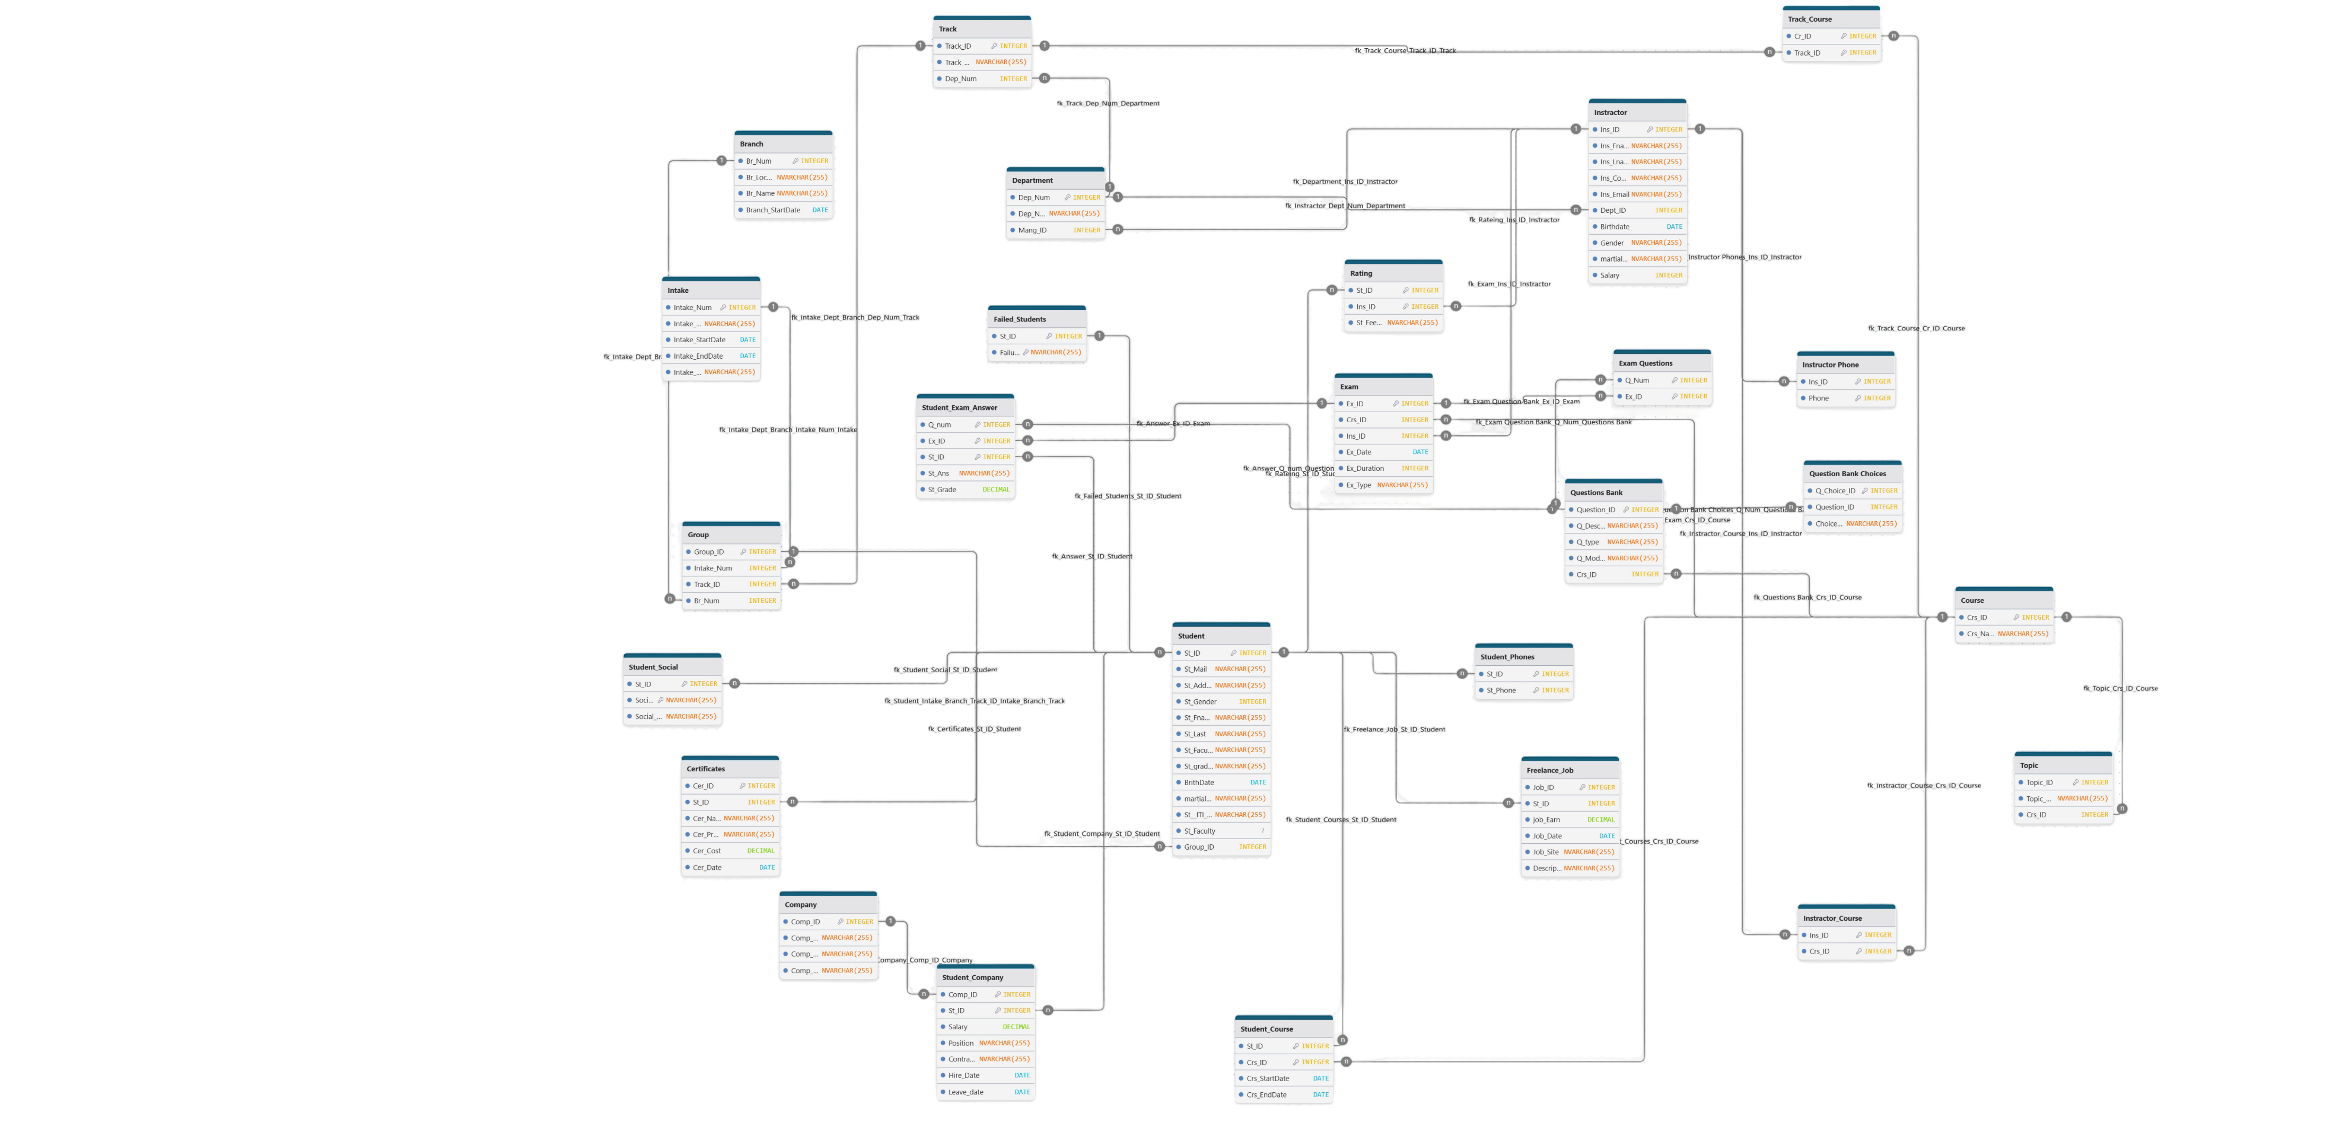
2
Mapping
1
ERD

Slide 5
3
Database
Database Creation
Data Generation
Procedures
Triggers
2
Mapping
1
ERD

Slide 6
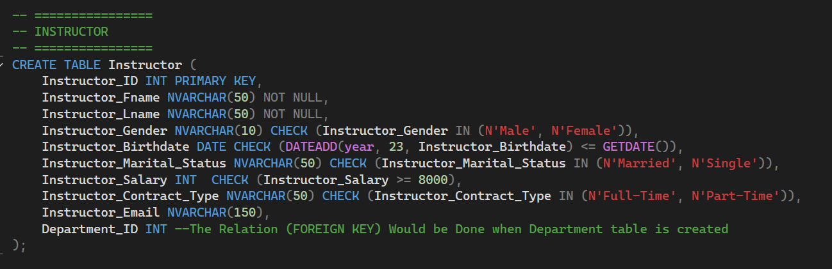
26 Table from 6 Categories
INSTRUCTOR
STUDENT
ORGANIZATIONAL STRUCTURE
EMPLOYMENT
COURSE
EXAMS & QUESTIONS
(Instructor , Instructor_Phone) Tables
(Department , Intake, Branch, Track, Group) Tables
(Student , Failed_Students, Student_Phone, Student_Social, Freelance_Job , Certificate, Rating) Tables
(Company , Student_Company) Tables
(Course ,Topics , Track_Course , Instructor_Course, Student_Course ) Tables
(Exam, Question_Bank, Question_Choice, Exam_Questions, Student_Exam_Answer ) Tables
3
Database
Database Creation
Data Generation
Procedures
Triggers
Creation Example
2
Mapping

Slide 7
Static Data Generation Example
Records: Approximately 2990 records inserted across multiple blocks
Pattern: Questions are linked to specific Course_IDs.
Pattern: Choices are linked to specific Question_IDs (only for 'MCQ' type questions). Choice_Text contains the potential answer options. Typically 3 choices per MCQ.
Question_Bank Table:
Question_Choice Table:
15 Question *7 Courses * 27 track + 50 for soft skills common between all tracks
Dynamic Data Generation Example
Step 1: Create 'Normal' Exams (Exam Table):
Records: 6192 inserted (516 groups * 12 courses/group).
Pattern: One 'Normal' exam is created for every course associated with every (group) that has students enrolled.
Records: 61920 inserted (6192 exams * 10 questions/exam).
Pattern: Each ‘Normal' exam created in Step 1 is assigned exactly 10 questions randomly selected from the Question_Bank for the corresponding Course_ID.
Step 3: Generate Initial 'Normal' Answers:
Records: 1,548,000 generated (25 students * 516 groups * 12 courses * 10 questions).:
Bias: A CorrectAnswerProbability is calculated for each student based on: Student_Faculty_Grade , Intake_Start_Date , Branch_Name
Step 2: Populate 'Normal' Exams (Exam_Questions Table):
Data Generation
Database Creation
3
Database
26 Table from 6 Categories
INSTRUCTOR
STUDENT
ORGANIZATIONAL STRUCTURE
EMPLOYMENT
COURSE
EXAMS & QUESTIONS
(Instructor , Instructor_Phone) Tables
(Department , Intake, Branch, Track, Group) Tables
(Student , Failed_Students, Student_Phone, Student_Social, Freelance_Job , Certificate, Rating) Tables
(Company , Student_Company) Tables
(Course ,Topics , Track_Course , Instructor_Course, Student_Course ) Tables
(Exam, Question_Bank, Question_Choice, Exam_Questions, Student_Exam_Answer ) Tables
Creation Example
Database size after data generation : 1.744 GB

Slide 8
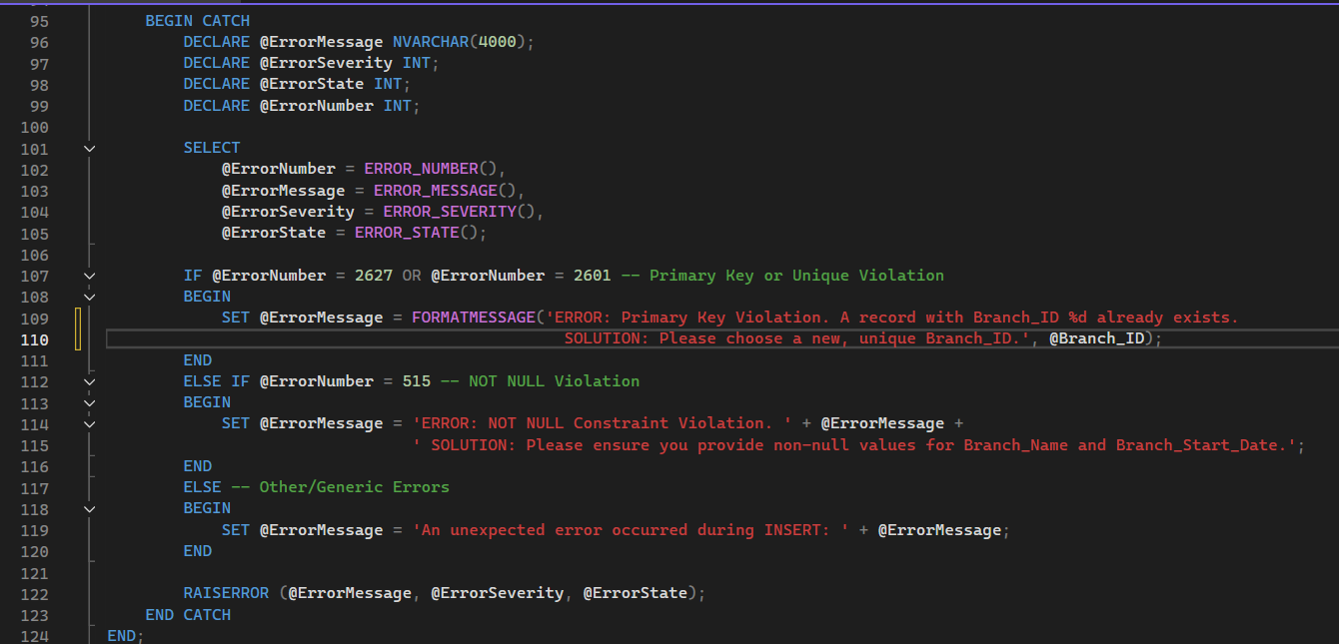
Procedures
3
Database
Data Generation
113 Procedure
Error Handling
4 (Select ,Insert ,Update , Delete ) * 26 (Tables Number) = 104
3 Custom Procedures
6 Report’s Procedure
Each error with custom massage
Primary key violation
Foreign key violation
Not Null Violation
Unique Violation
Static Data Generation Example
Records: Approximately 2990 records inserted across multiple blocks
Pattern: Questions are linked to specific Course_IDs.
Pattern: Choices are linked to specific Question_IDs (only for 'MCQ' type questions). Choice_Text contains the potential answer options. Typically 3 choices per MCQ.
Question_Bank Table:
Question_Choice Table:
15 Question *7 Courses * 27 track + 50 for soft skills common between all tracks
Dynamic Data Generation Example
Step 1: Create 'Normal' Exams (Exam Table):
Records: 6192 inserted (516 groups * 12 courses/group).
Pattern: One 'Normal' exam is created for every course associated with every (group) that has students enrolled.
Records: 61920 inserted (6192 exams * 10 questions/exam).
Pattern: Each ‘Normal' exam created in Step 1 is assigned exactly 10 questions randomly selected from the Question_Bank for the corresponding Course_ID.
Step 3: Generate Initial 'Normal' Answers:
Records: 1,548,000 generated (25 students * 516 groups * 12 courses * 10 questions).:
Bias: A CorrectAnswerProbability is calculated for each student based on: Student_Faculty_Grade , Intake_Start_Date , Branch_Name
Step 2: Populate 'Normal' Exams (Exam_Questions Table):
Database size after data generation : 1.744 GB

Slide 9
Triggers
Procedures
3
Database
113 Procedure
Error Handling
4 (Select ,Insert ,Update , Delete ) * 26 (Tables Number) = 104
3 Custom Procedures
6 Report’s Procedure
Each error with custom massage
Primary key violation
Foreign key violation
Not Null Violation
Unique Violation
Static Data Generation Example
Records: Approximately 2990 records inserted across multiple blocks
Pattern: Questions are linked to specific Course_IDs.
Pattern: Choices are linked to specific Question_IDs (only for 'MCQ' type questions). Choice_Text contains the potential answer options. Typically 3 choices per MCQ.
Question_Bank Table:
Question_Choice Table:
15 Question *7 Courses * 27 track + 50 for soft skills common between all tracks
Dynamic Data Generation Example
Step 1: Create 'Normal' Exams (Exam Table):
Records: 6192 inserted (516 groups * 12 courses/group).
Pattern: One 'Normal' exam is created for every course associated with every (group) that has students enrolled.
Records: 61920 inserted (6192 exams * 10 questions/exam).
Pattern: Each ‘Normal' exam created in Step 1 is assigned exactly 10 questions randomly selected from the Question_Bank for the corresponding Course_ID.
Step 3: Generate Initial 'Normal' Answers:
Records: 1,548,000 generated (25 students * 516 groups * 12 courses * 10 questions).:
Bias: A CorrectAnswerProbability is calculated for each student based on: Student_Faculty_Grade , Intake_Start_Date , Branch_Name
Step 2: Populate 'Normal' Exams (Exam_Questions Table):
Database size after data generation : 1.744 GB
Audit Table
User Name & Device Name
Action Type
Modified Table
Date & Time
Record Before Action
Record After Action
Data Generation

Slide 10
113 Procedure
Error Handling
4 (Select ,Insert ,Update , Delete ) * 26 (Tables Number) = 104
3 Custom Procedures
6 Report’s Procedure
Each error with custom massage
Primary key violation
Foreign key violation
Not Null Violation
Unique Violation
4
BI Tools
3
Database
Triggers
Audit Table
User Name & Device Name
Action Type
Modified Table
Date & Time
Record Before Action
Record After Action
Modified Coulmn
Procedures
SSIS
SSAS
Quik Analysis and insights
Cube (Branch Performance)
Extract from OLTP(Enormous data to handle )
Transform throw SQL commands and lookups
Load to data warehouse for dashboards and analysis
Cube (Student Performance)

Slide 11
SSRS
4
BI Tools
SSIS
SSAS
Quik Analysis and insights
Cube (Branch Performance)
Extract from OLTP(Enormous data to handle )
Transform throw SQL commands and lookups
Load to data warehouse for dashboards and analysis
Cube (Student Performance)
Audit Table
User Name & Device Name
Action Type
Modified Table
Date & Time
Record Before Action
Record After Action
Triggers
3
Database

Slide 12

5
Dashboards
4
BI Tools
SSRS
Tableau
SSIS
SSAS
Quik Analysis and insights
Cube (Branch Performance)
Extract from OLTP(Enormous data to handle )
Transform throw SQL commands and lookups
Load to data warehouse for dashboards and analysis
Cube (Student Performance)

Slide 13
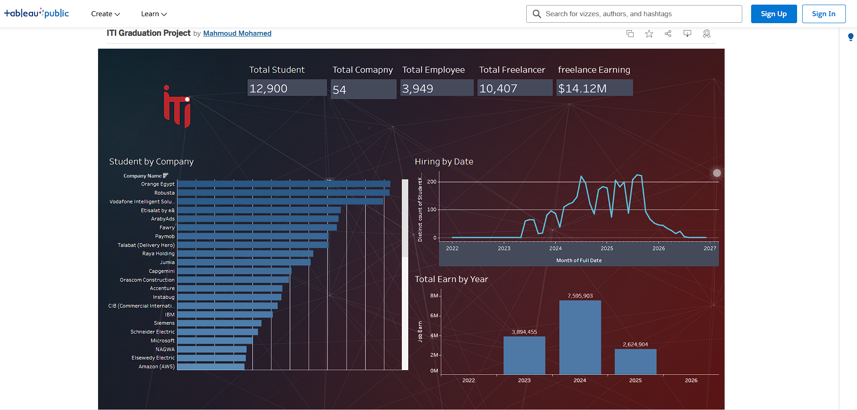
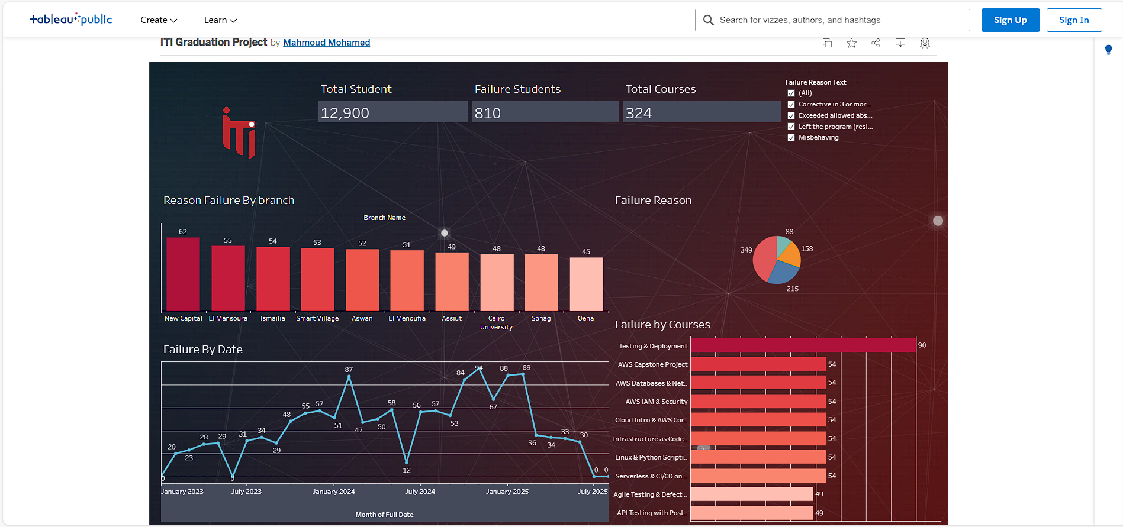
Power BI
5
Dashboards
Tableau
SSRS
4
BI Tools

Slide 14
6
AI Models
5
Dashboards
Power BI
Tableau
SSRS
4
BI Tools

Slide 15
6
AI Models
Grades Prediction
Employment Prediction
Text To SQL
Generate Dashboard
AI Demo
5
Dashboards
Power BI

Slide 16
6
AI Models
AI Demo
Grades Prediction
Employment Prediction
Text To SQL
Generate Dashboard
5
Dashboards

Slide 17
AI Demo
6
AI Models

